Slide 1
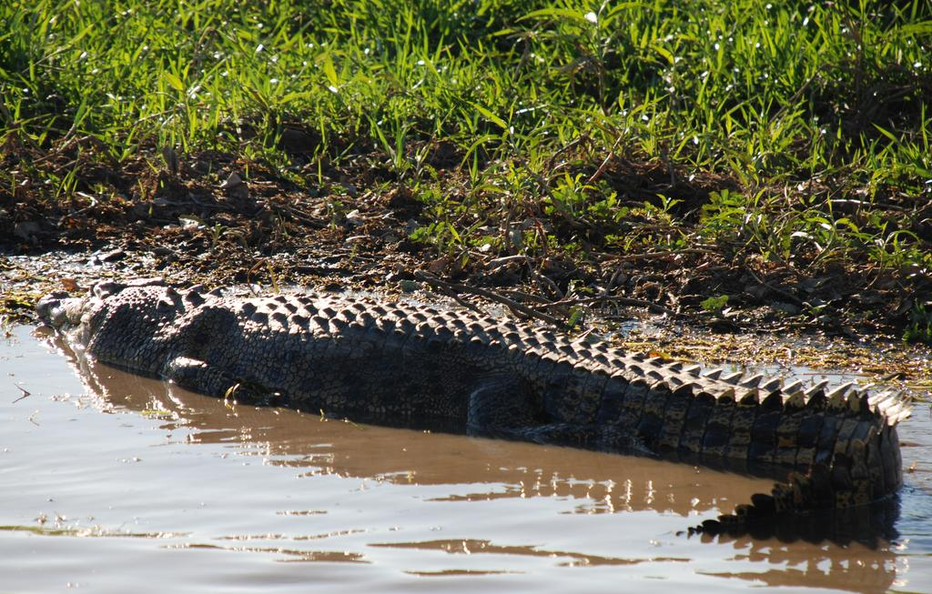
What do we know about Metals and Radionuclides coming from The Ranger Mine??
Alligator River’s Region, Australia
Preston Scott, Scott Braley, Chloe Stenkamp-Strahm
R Programming, Fall 2016

Slide 2
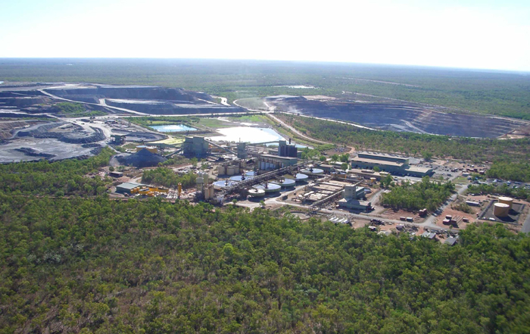
Ranger Uranium Mine, operational from 1980 - present

Slide 3
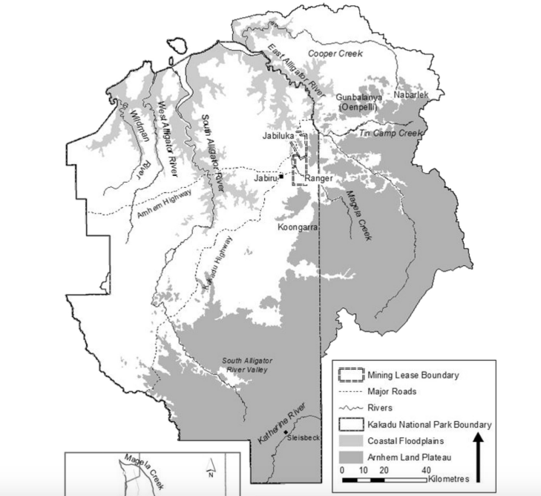
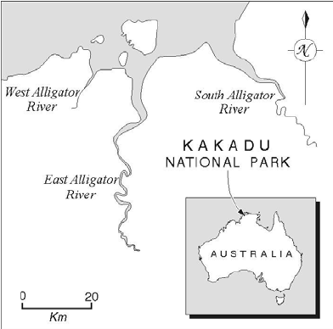
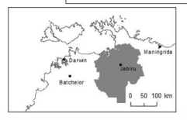
Alligator Rivers Region
Doering and Boellhofer, 2016

Slide 4
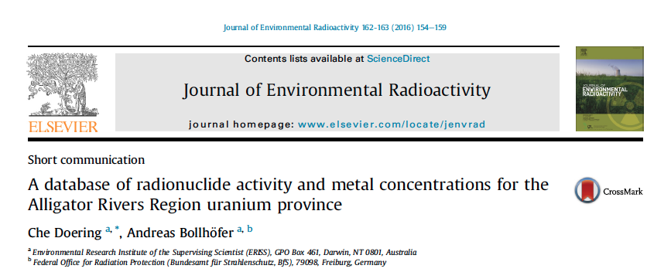
‘Environmental Research Institute of the Supervising Scientist’

Slide 5
Why do we want to look at animal/environmental radionuclide and metal concentrations in the region??
Impacts on Kakadu National Park (1/3 of land is park)
Overall impacts of uranium mining on water and fauna (2/3 of land is aboriginal owned)
Concerns about contamination of bush foods, contamination of flora for wild animal consumption
Notes:
Mining is slated to cease in 2021, with remediation done by 2026 so the land can be incorporated into the national park
Edible tissues of wild plants and animals that are traditionally hunted by and gathered by aboriginal people for sustenance

Slide 6
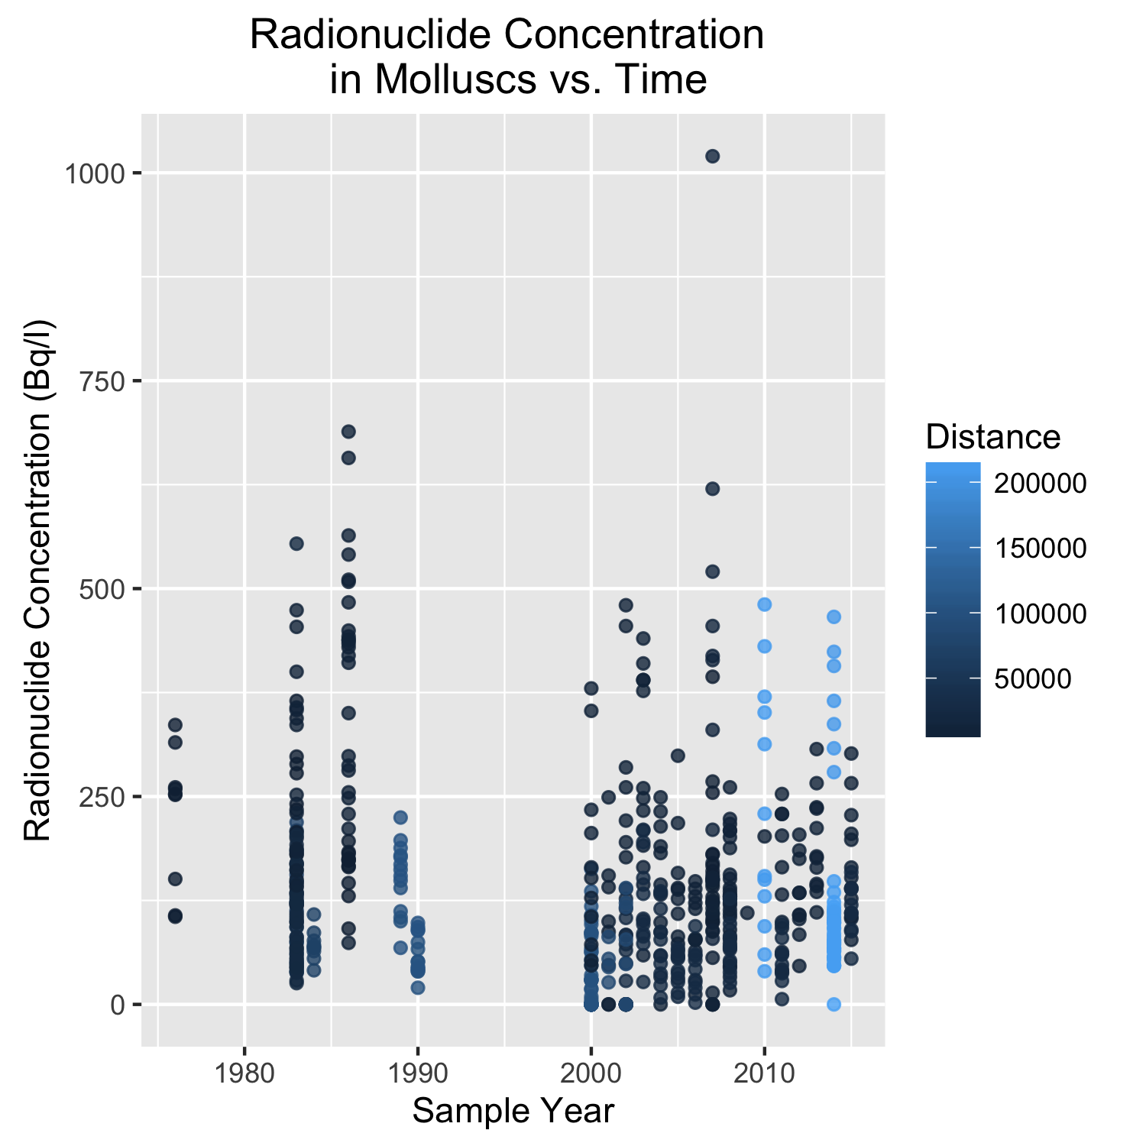
There is some evidence for pre- and post- mining change…...

Slide 7
What have we chosen to look at in this data set??
Sample types:
Terrestrial Animals
Freshwater Animals
Terrestrial Plants
Freshwater Plants
Terrestrial Soil
Freshwater Sediment
Mollusc
Fish
Water
Date: 11/2/1976 to 11/30/2015
Location: Distance (km) from the mine
Measurements:
Metals: Cu, As, Pb, Hg
Radionuclides (summed):
U238
U234
Th230
Ra226
Pb210
Po210
Th232
Ra228
Th228
Ac227
K40
Notes:
Radionuclides can sum (and given reasoning)
Selected these 4 metals because we know that they have specific disease outcomes in large mammals, and can bioaccumulate

Slide 8
What questions have we decided to ask?
Overarching: How has the Ranger Mine contaminated the surrounding Alligators River Region with radionuclides and metals?
Specifically:
Where are the sample types of interest located in relation to the mine?
How does the concentration of radionuclides and metals change with distance from the mine?

Slide 9
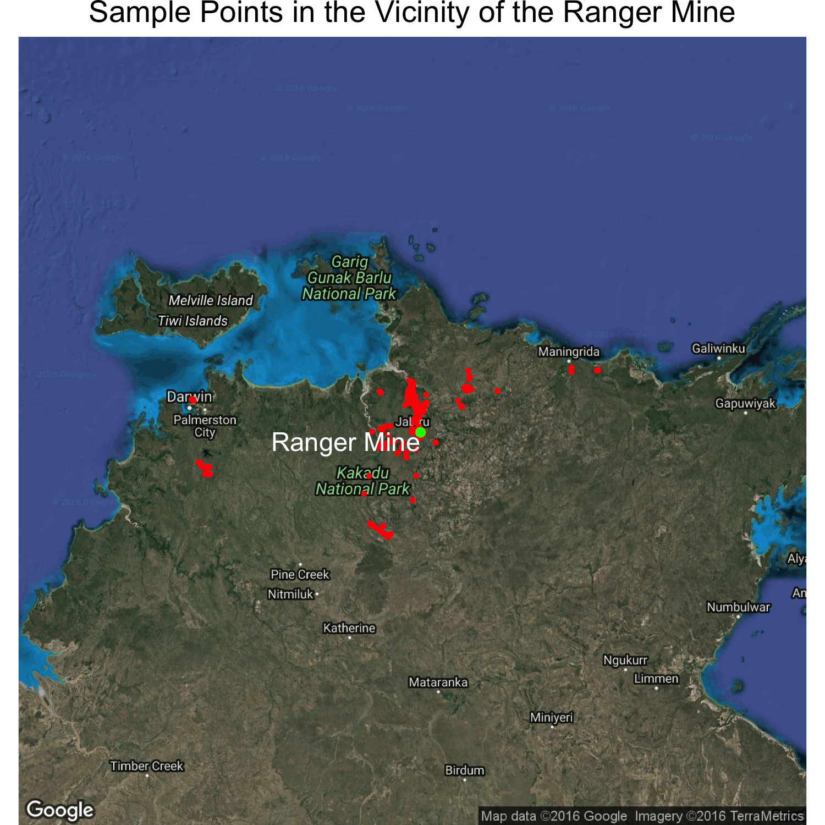
Where are the sample types of interest located in relation to the mine?

Slide 10
Where are the sample types of interest located in relation to the mine?
Insert ggmap, zoomed in, coded by sample type

Slide 11
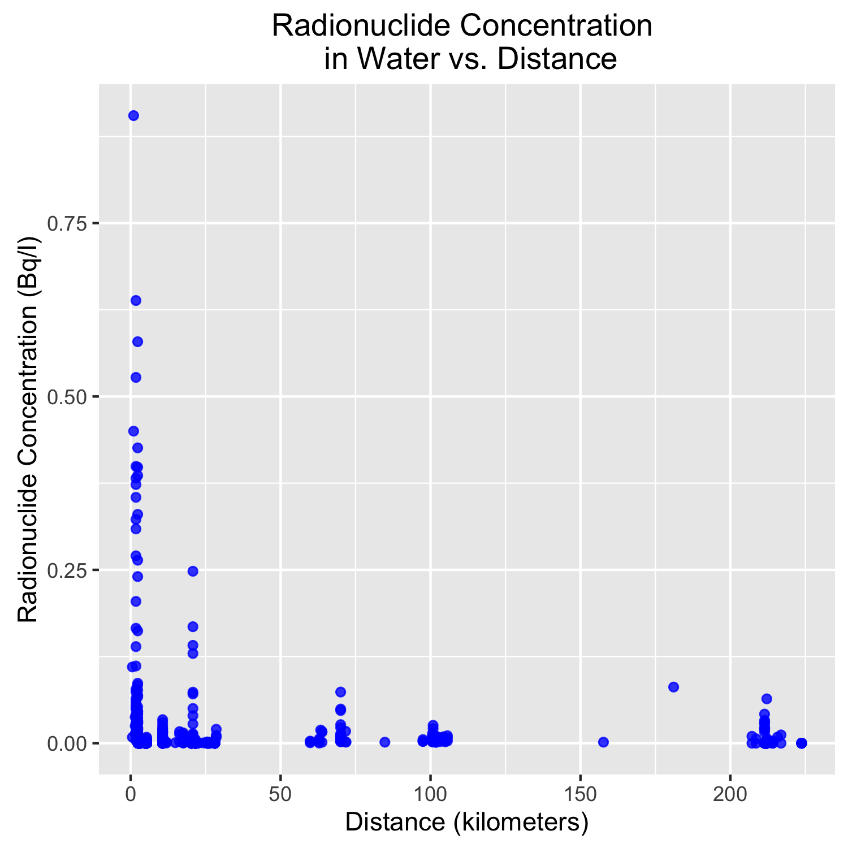
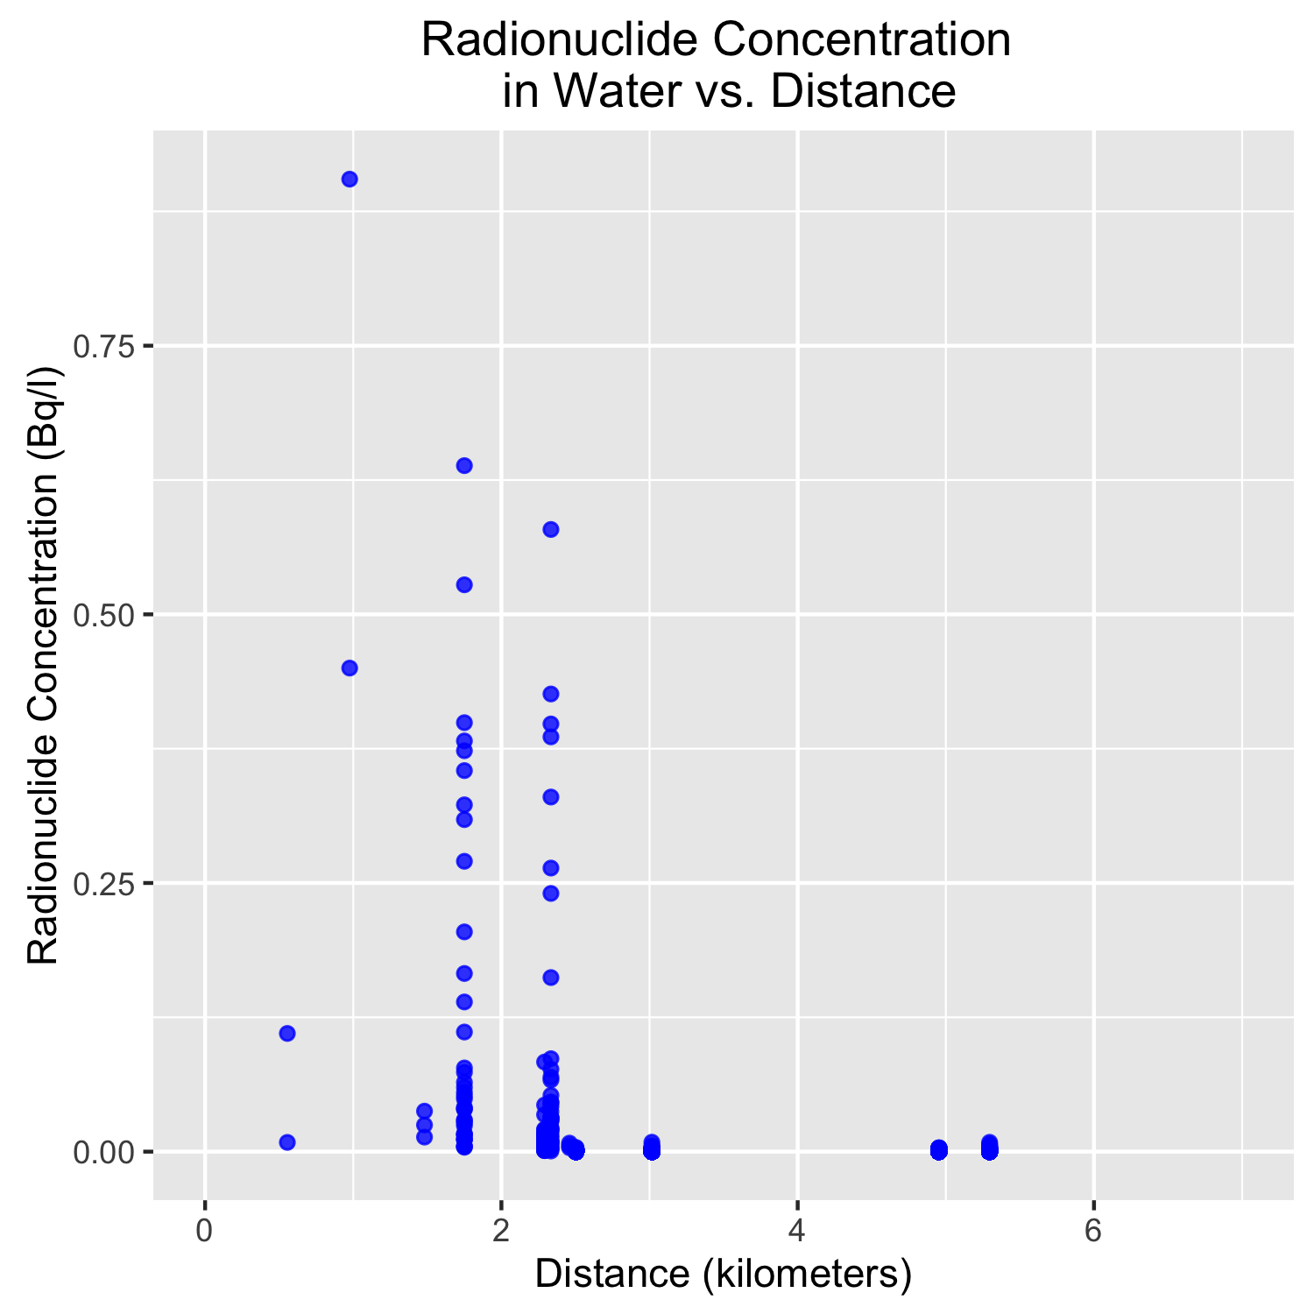
How does the concentration of radionuclides change with distance from the mine?

Slide 12
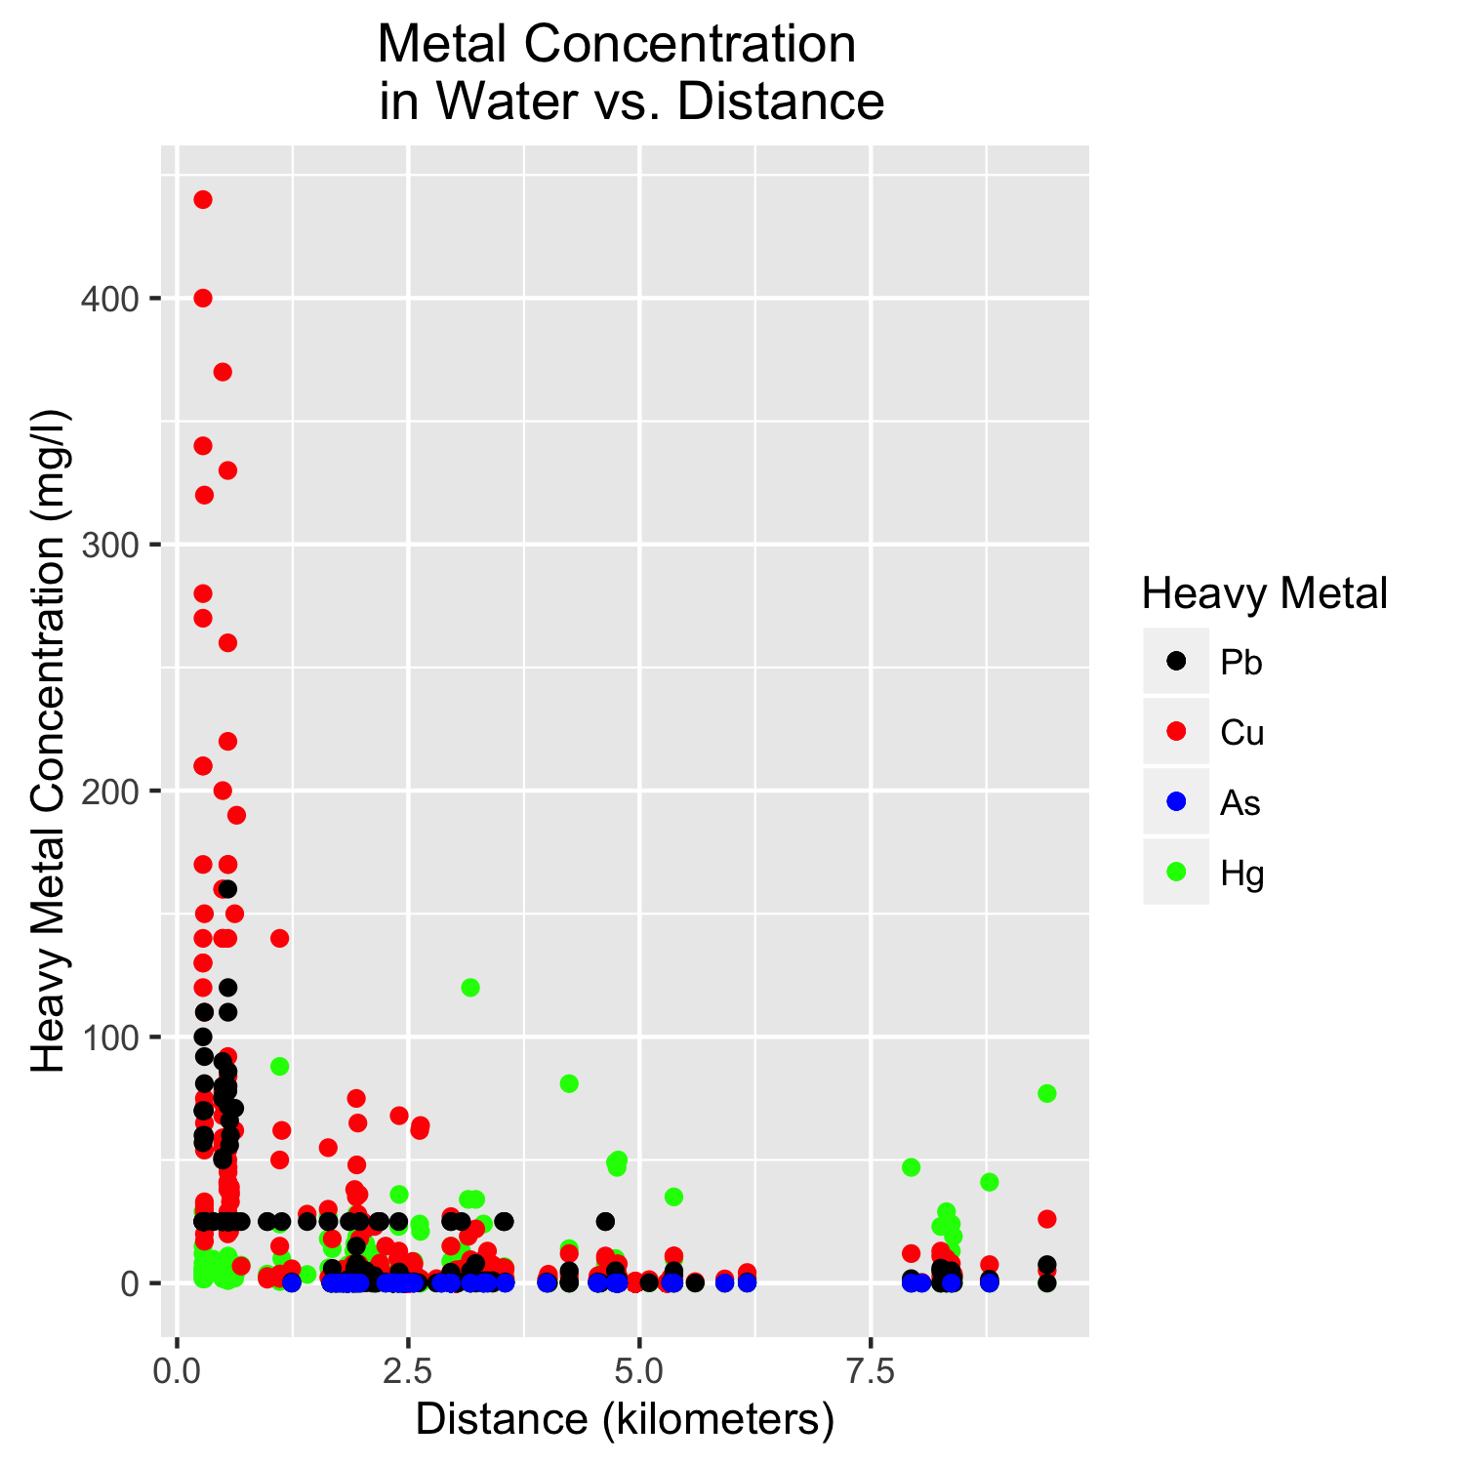
How does the concentration of metals change with distance from the mine?

Slide 13
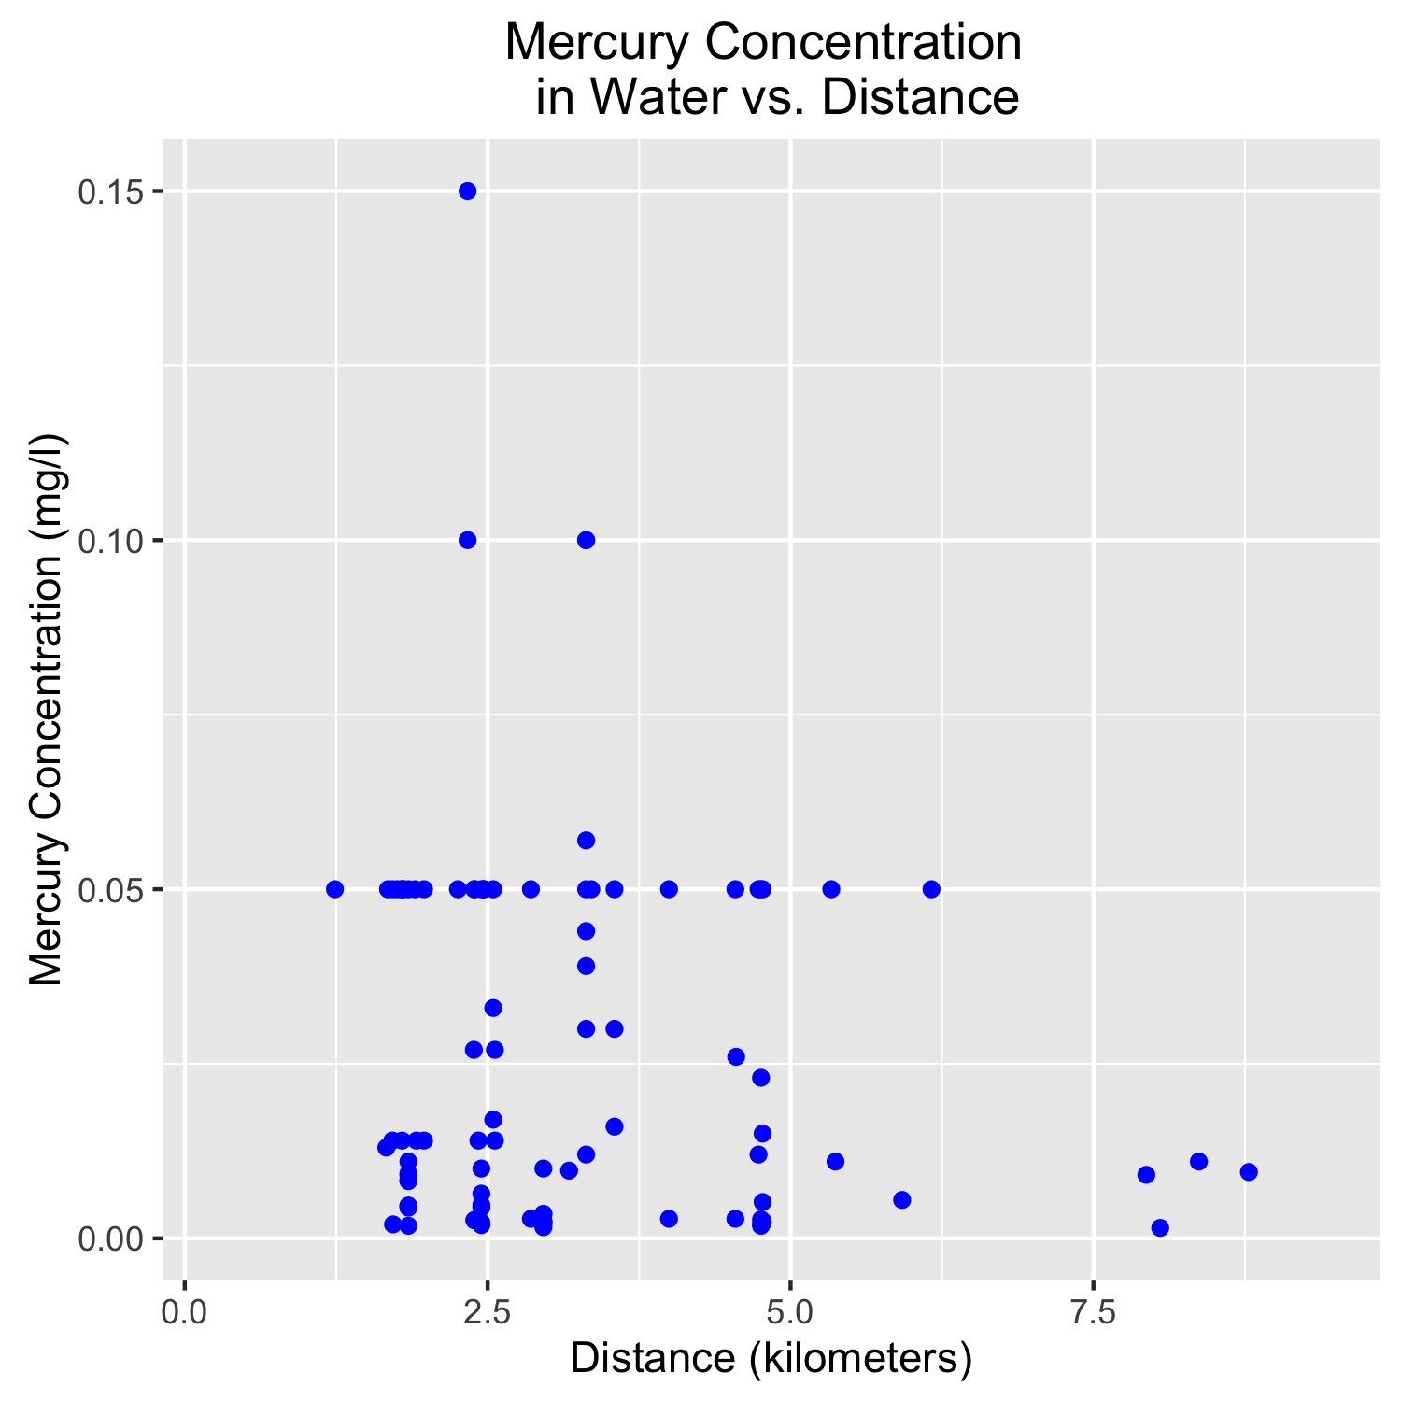
How does the concentration of metals change with distance from the mine?

Slide 14
Now we can look at sample type, distance, time, and concentration of contaminant together
SHINY!!!!!

